Slide 1
READ ME This template uses the font ‘Space Grotesk’ and ‘Open Sans’ for English and ‘Nanum Gothic / 나눔고딕’ for Korean – be sure to download the font before making edits to the deck. Here’s the link to the ZIP file containing the font. If you cannot access the link above, you can download the font for free via Google Fonts.

Slide 3
Power Platform DevOps

Slide 4
Power Platform is great!

Slide 5
Power Platform can even be greater

Slide 6
Power Platform can even be greater with DevOps capability!

Slide 7
Why DevOps on Power Platform?

Slide 8
Tracking change history

Slide 9
Tracking change history
Easy deployment across environments

Slide 10
Tracking change history
Easy deployment across environments
Integrating CI/CD pipeline

Slide 11



GitHub Codespaces
Power Platform
Environment
GitHub

Slide 12

GitHub Codespaces
API
Power Platform
Environment
GitHub

Slide 13
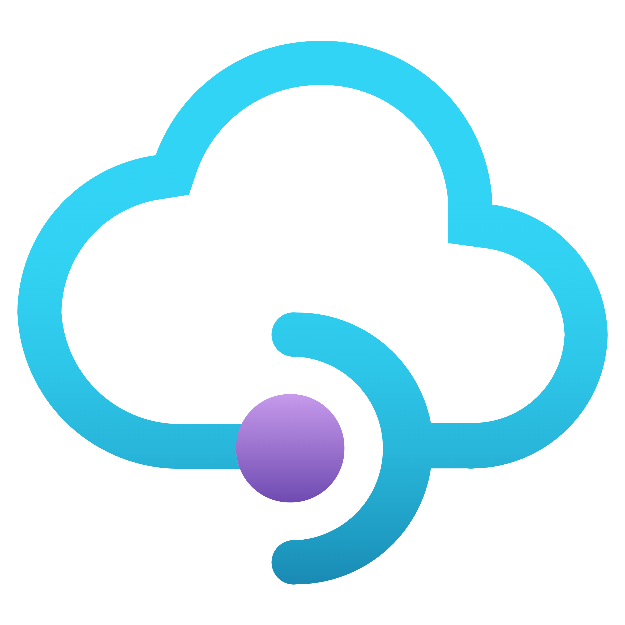
GitHub Codespaces
API Management
API
Power Platform
Environment
GitHub

Slide 14

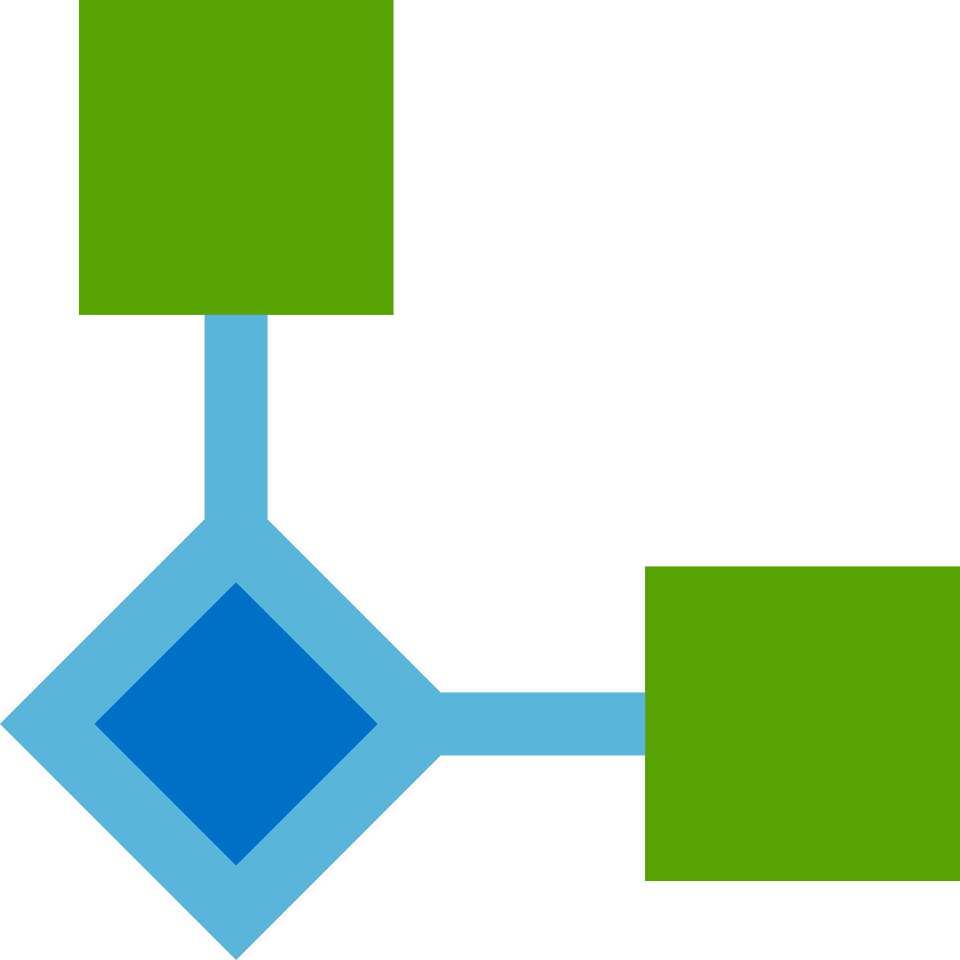
GitHub Codespaces
Power Automate
Custom Connector
API Management
API
Power Platform
Solution
GitHub

Slide 15

GitHub Codespaces
Power Automate
Custom Connector
API Management
API
Power Platform
Solution
Power Platform CLI
GitHub

Slide 16
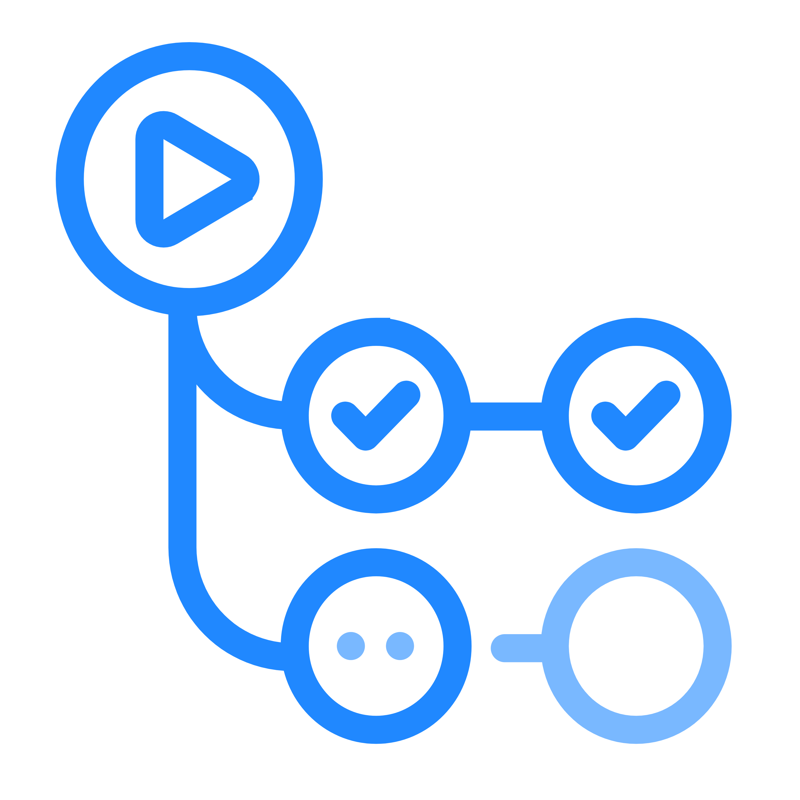
GitHub Codespaces
GitHub Actions
Power Automate
Custom Connector
API Management
API
Power Platform
Solution
Power Platform CLI
GitHub

Slide 17
Fork to your account
aka.ms/gppbkr/appdev-in-a-day

Slide 18
Getting Started
aka.ms/gppbkr/appdev-in-a-day/devops

